Slide 1

Project presentation
Overview
By Bohua Jia & Dipanjan Banik

Slide 2
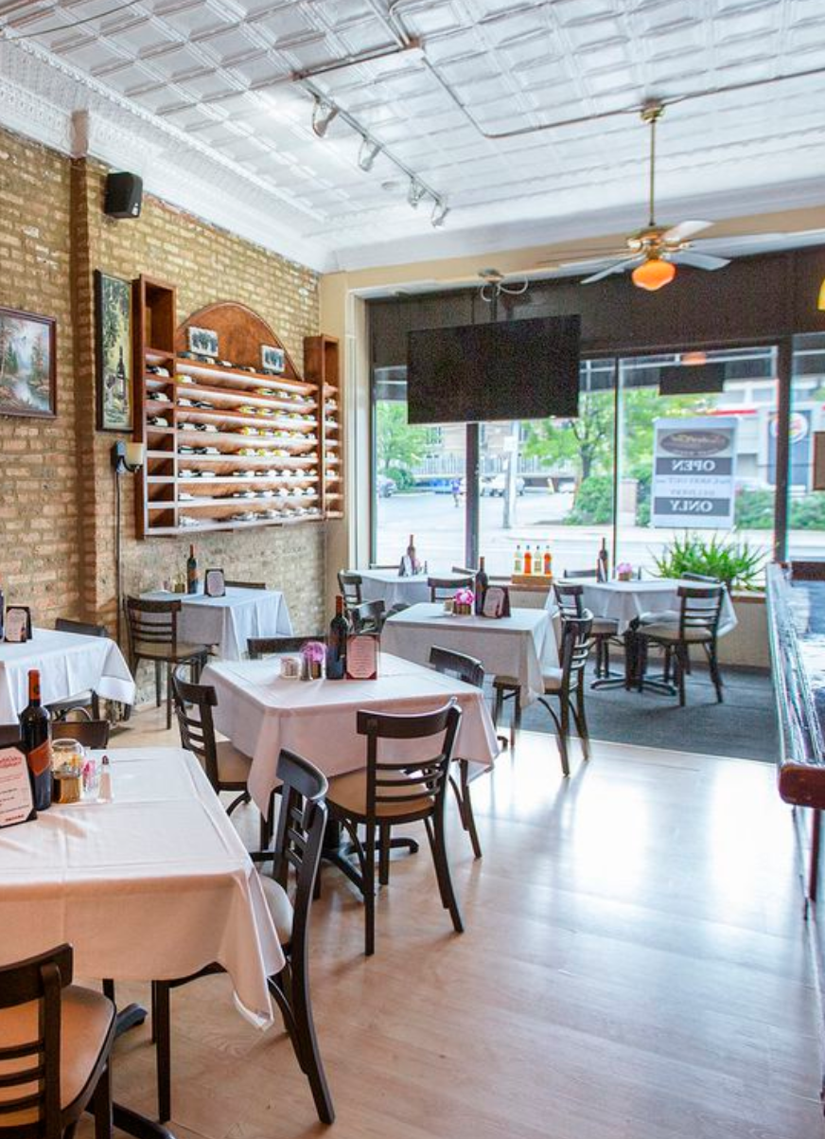
Use case
Restaurant Recommendation challenge
From Kaggle
Train_full
contains 5.8 millions of rows
73 columns
3.1GB
Test_full
contains 1.6 millions of rows
72 columns
1 GB

Slide 3
Use case
Aim
Giving a recommendation of a vendor to the customer.
Customer info
Vendor info
Each customer can order from multiple locations (LOC_NUM)
There are ~10,000 customers in the test set.
There are ~35,000 customers in the train set.
Some of these customers have made orders at least one of vendors.

Slide 4
Related works
Supervised learning
Train the machine with some data that is already labelled correctly.
New sets of data are given to the machine, expecting it to generate the correct outcome based on its previous analysis of the labelled data.
Random forest
Combines the output of multiple decision trees to reach a single result.
It can handle both classification and regression problems.
Apache Spark
An open-source parallel processing framework that supports in-memory processing to boost the performance of applications that analyze big data.

Slide 5
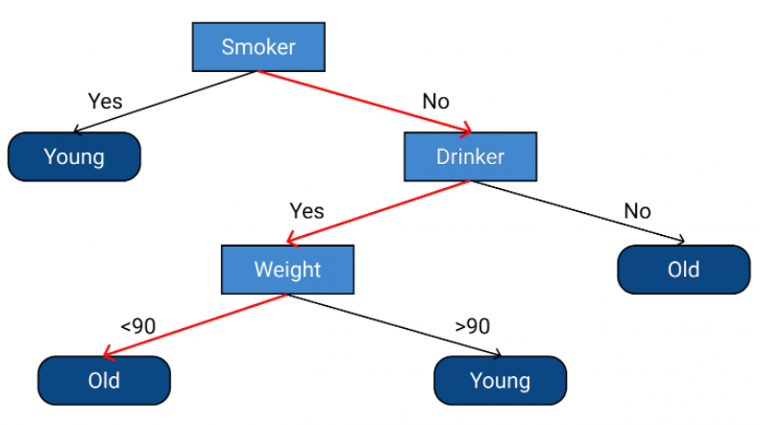
Algorithms
Decision tree
A Decision tree is a flowchart like tree structure
Each internal node denotes a test on an attribute
Each branch represents an outcome of the test
Each leaf node (terminal node) holds a class label.

Slide 6

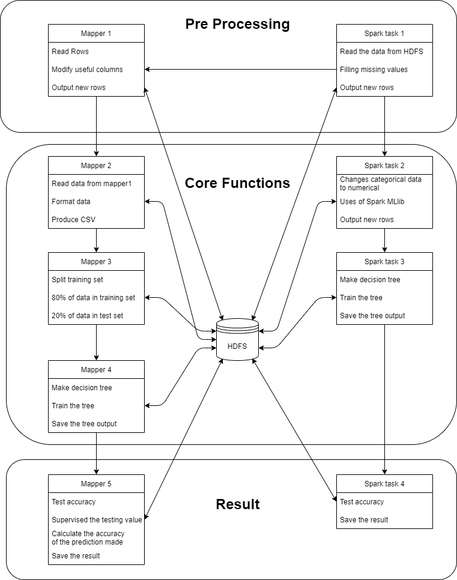



Working flow

Slide 7


Slide 8

Hadoop
Convert the output of preprocessing to csv file.
Import package from outside.
Build the decision tree on 80% of dataset.

Slide 9

spark
Setting up the environment in all cluster
Difference between pandas dataframe and spark dataframe
Testing code take much time

Slide 10
Result
Spark-filling missing value: 4 hours 57 mins
Hadoop-preprocessing: 1 hour 10 mins
Hadoop-produce csv file: 2 mins
...

Slide 11
Thank you for listening

